Slide 1
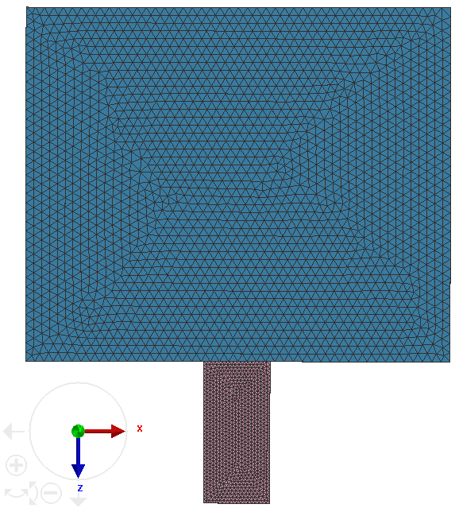
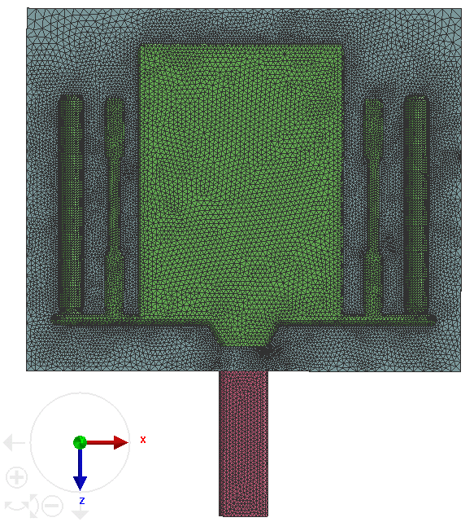
Simulation – Mesh
Total elements are 1,402,468, with surface mesh 96,084 and volume mesh 1,306,384.
Minimum element size is 2.5 mm on the four casting rods/bars.
For simplicity, only filling and solidification for one cycle are simulated.
With right cover die
Without right cover die

Slide 2
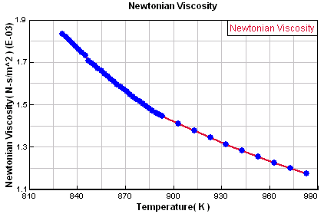
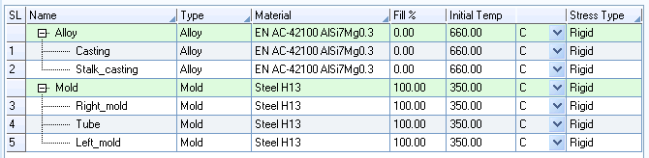
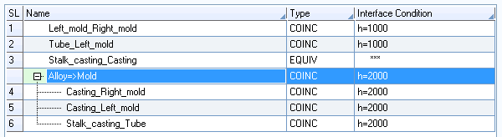
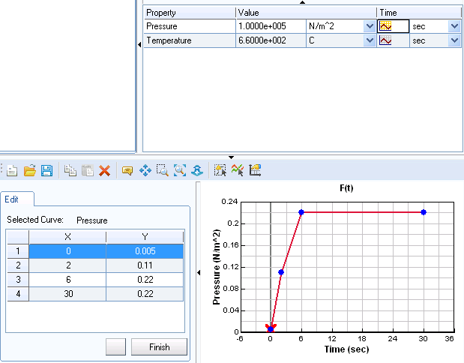
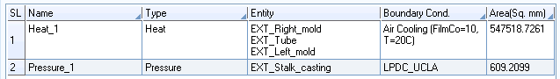
Simulation parameters
Casting alloy is AC-42100 (similar to A356), with initial temperature = T_{L} + 50 °C.
Mold is steel H13, with preheat temperature 350 °C.
Both materials properties are used the default in ProCAST.
A356 viscosity
Heat transfer coefficient between A356 and steel H13 is considered as a constant number. While ideally a temperature-dependent value would be more accurate.
Pressure profile
Boundary conditions include surface air cooling and pressure profile.
Displacement is not considered for stress calculation.

Slide 3
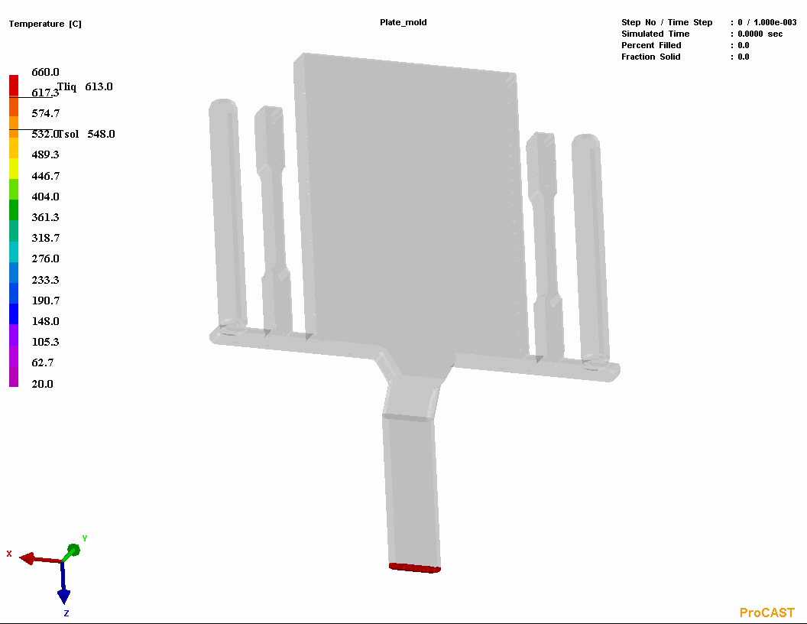
Preliminary results
Temperature profile during filling

Slide 4
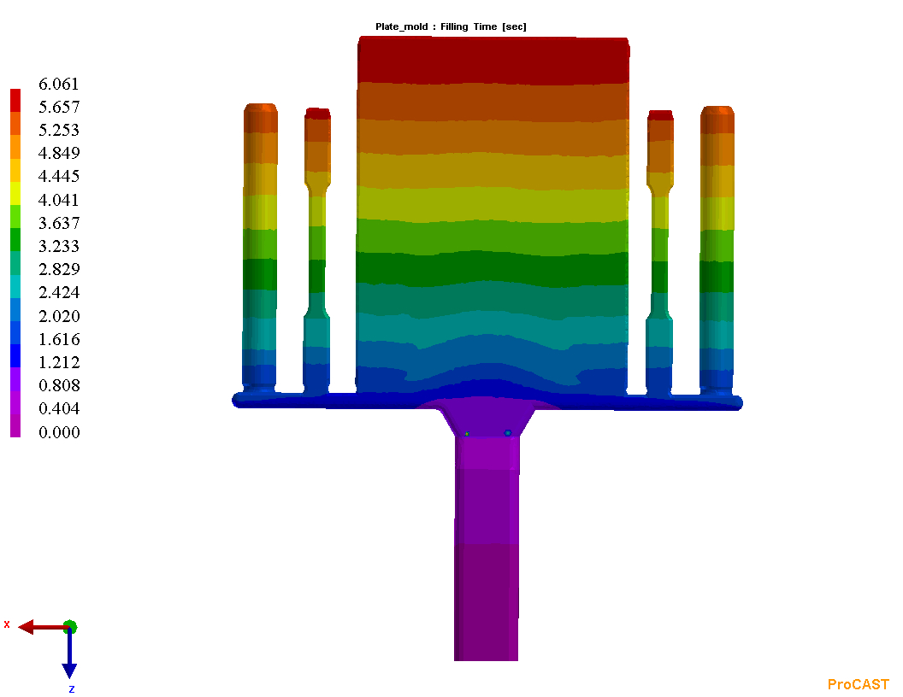
Preliminary results – Filling time
Flow pattern in previous slide presents a uniform filling from bottom to up. This is also confirmed in filling time as shown in the right.
Sequential filling is obtained.

Slide 5
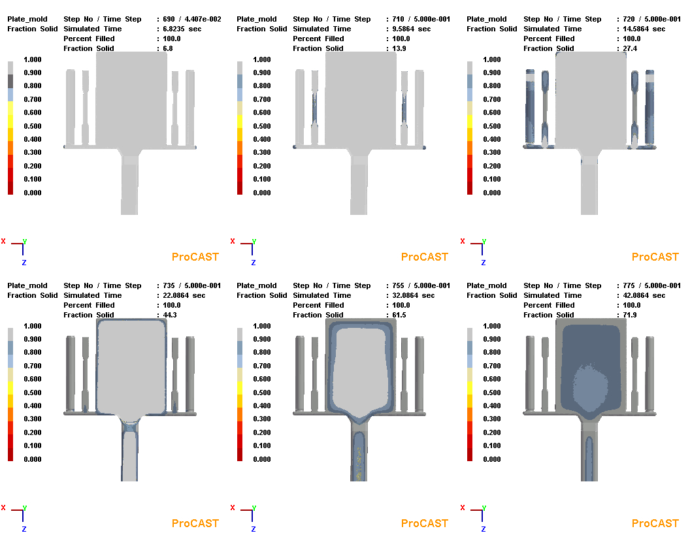
Preliminary results – Solidification sequence
Cutoff for fraction of solid at 70%.
First initiated at two side corners of the runner.
Then the middle portions of tensile bars solidified.
Due to the solidification in stalk, the last solidification in plate is susceptible to porosity.

Slide 6
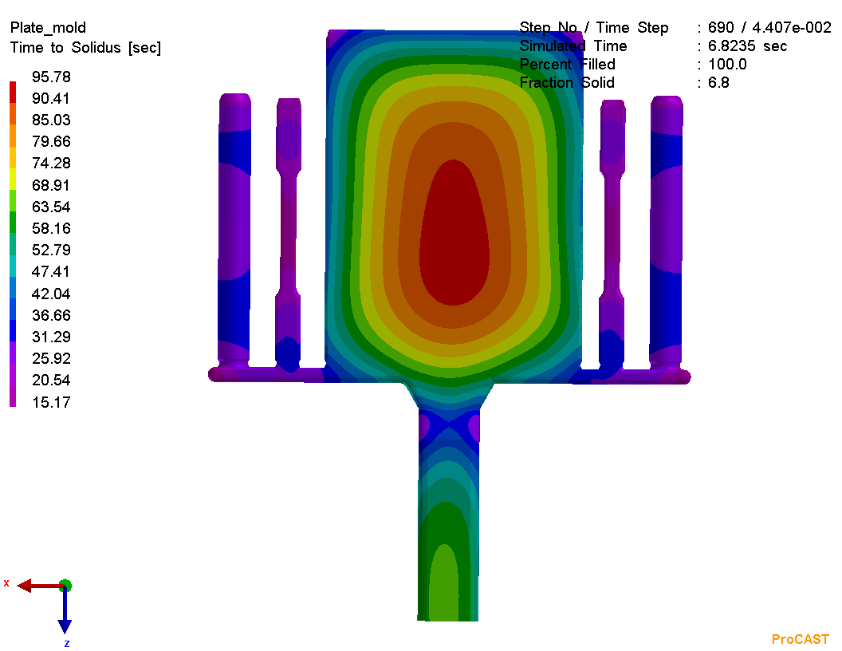
Preliminary results – Time to Solidus
Time to solidus result correlates well with previous solidification sequences.

Slide 7
Key inputs
Materials properties (mainly temperature-dependent), including
Thermal – Conductivity, density, enthalpy, fraction solid, T_{S} and T_{L}
Fluid – Viscosity
Stress (if we plan for future stress calculations) – Thermal expansion, Young’s modulus, Poisson’s ratio, yield stress and plastic modulus
Casting temperature and die temperature
Heat transfer coefficient (HTC) between alloy and die
Surface radiation in boundary condition (since there is no convection/conduction in vacuum chamber)
Pressure profiles in boundary condition.

